Slide 1
데이터 분석가를 위한
통계로 시작하는 Deep learning 강의
2018-08-08
Lee Jeong Hoon
Seoul National University of Bio-Medical Informatics

Slide 2
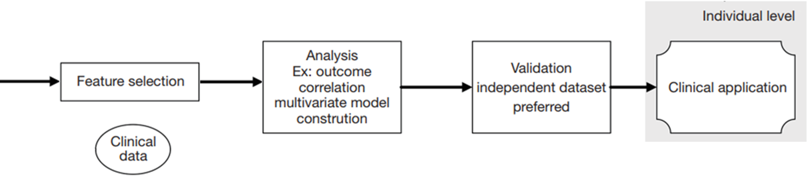

선형모델 Process
Ridge 회귀 모형
Raw Data
중요한 변수 선택
Modeling
모델 검증
실전 활용

Slide 3
인공 신경망 [Neural Network]

Slide 4
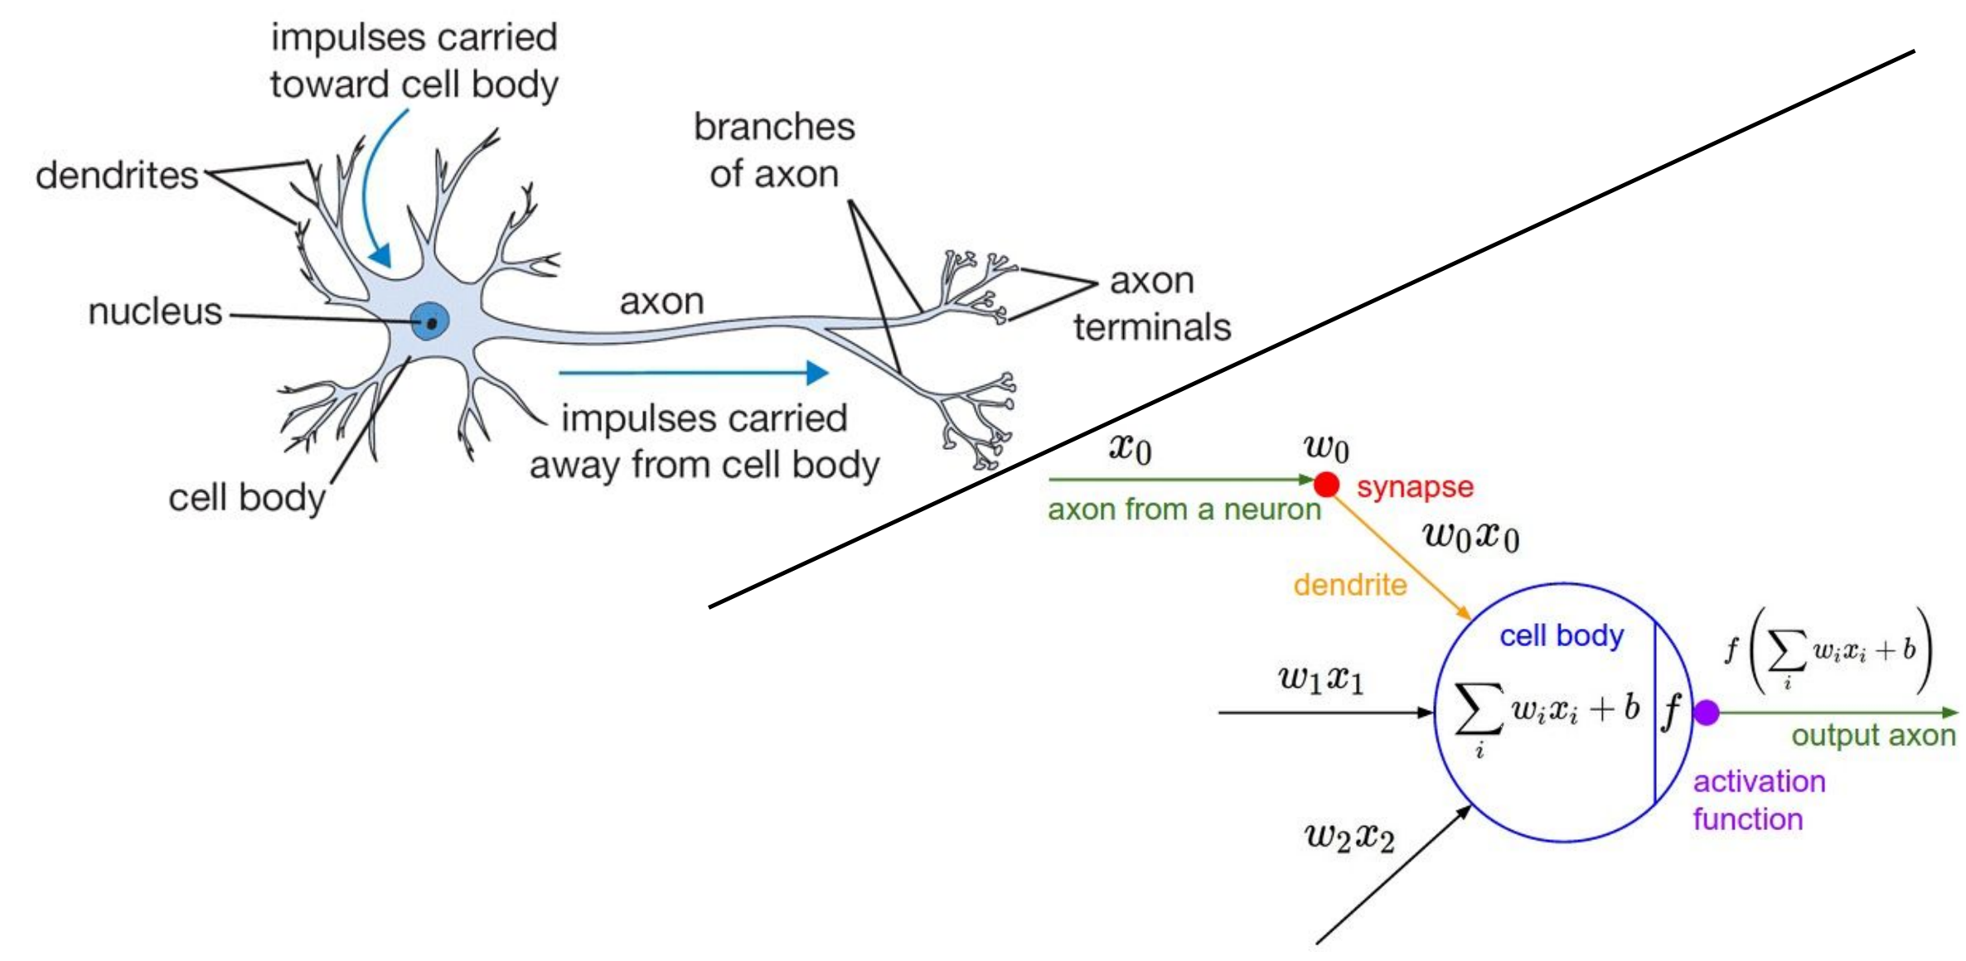
인공신경망 [Neural Network]
http://cs231n.stanford.edu/slides/2016/winter1516_lecture4.pdf

Slide 5
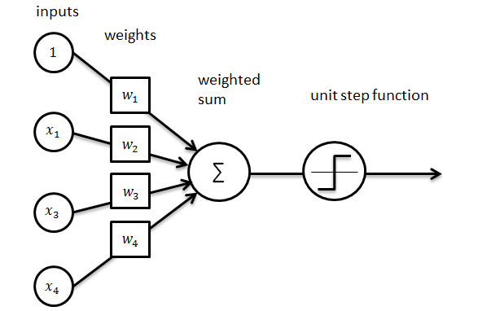
퍼셉트론 [Perceptron]

Slide 6
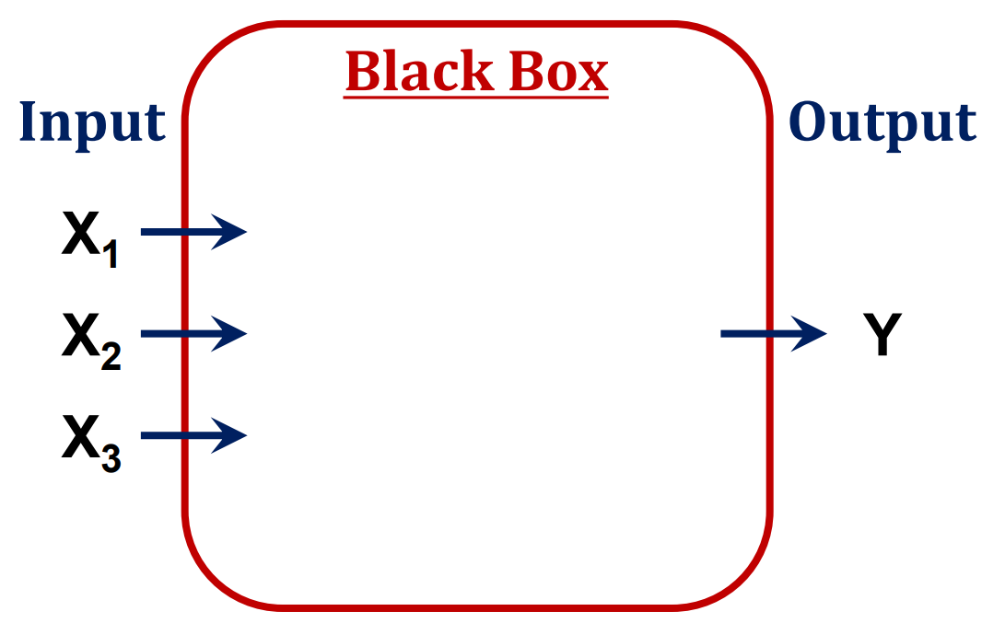
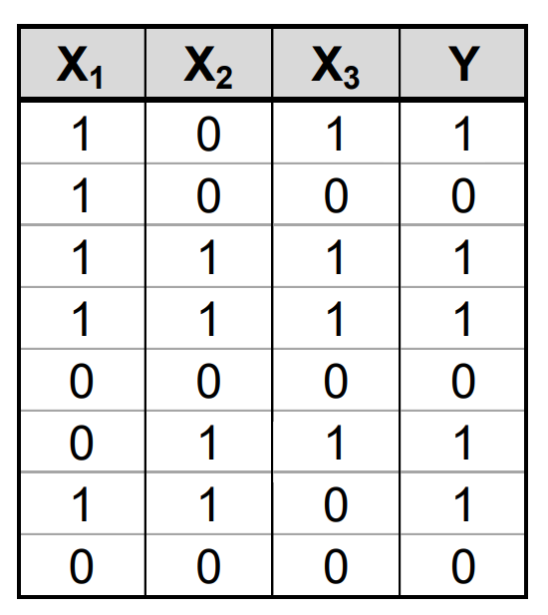
퍼셉트론 [Perceptron]

Slide 7
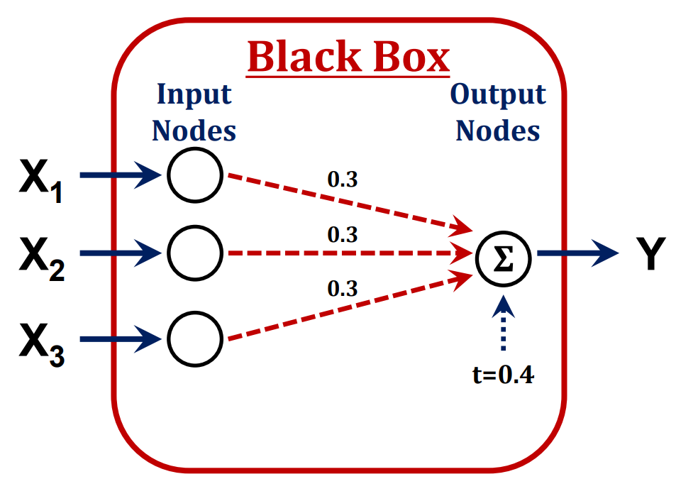
퍼셉트론 [Perceptron]

Slide 8
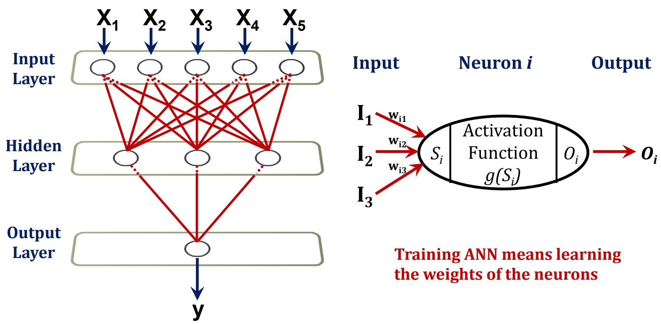
퍼셉트론 [Perceptron]

Slide 9

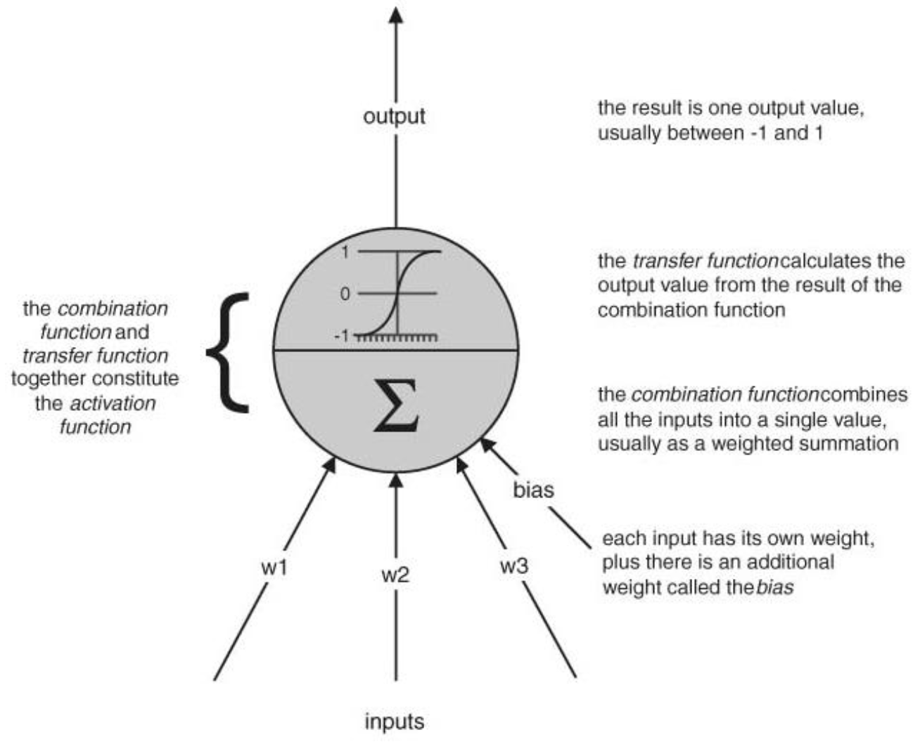
활성 함수 [Activation Function]

Slide 10

인공신경망

Slide 11
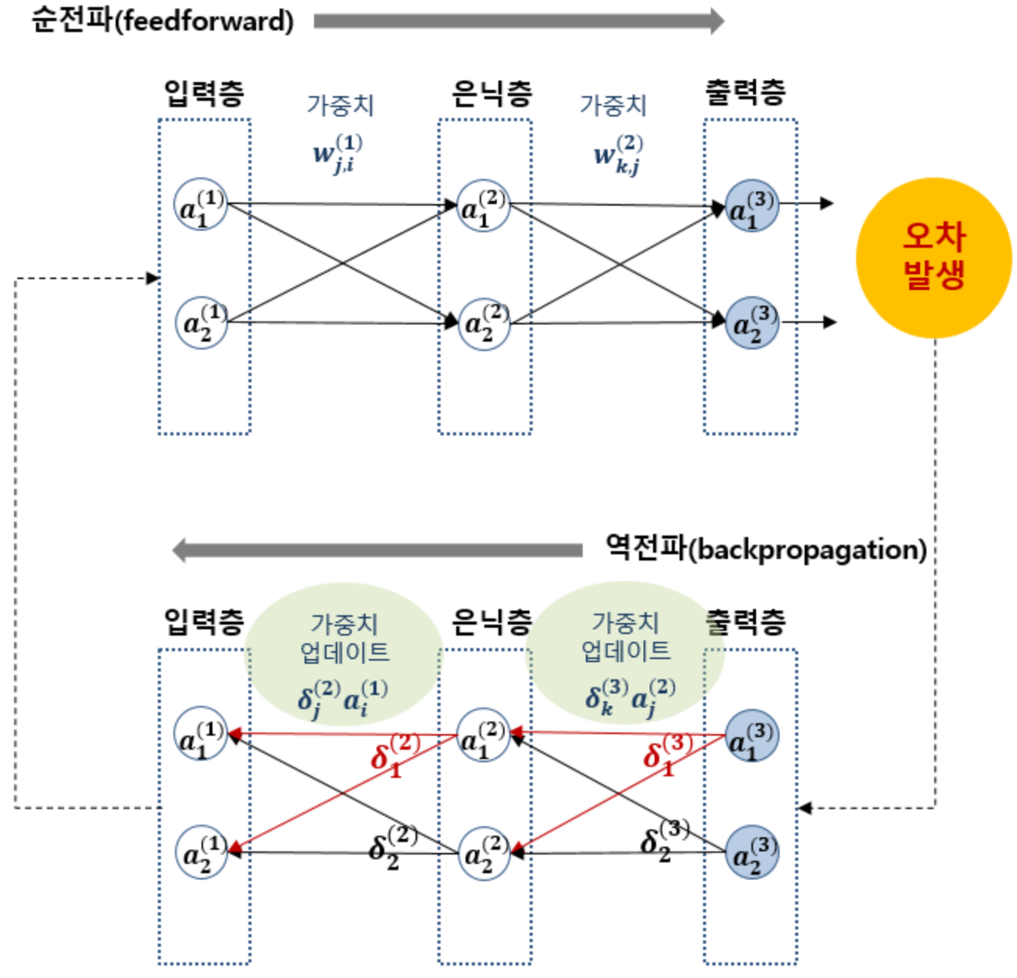
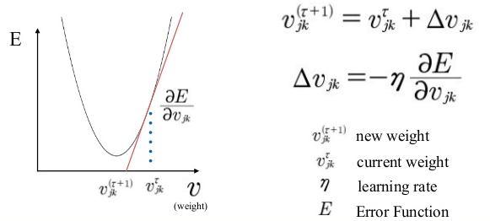
역전파 [Backpropagation]

Slide 12
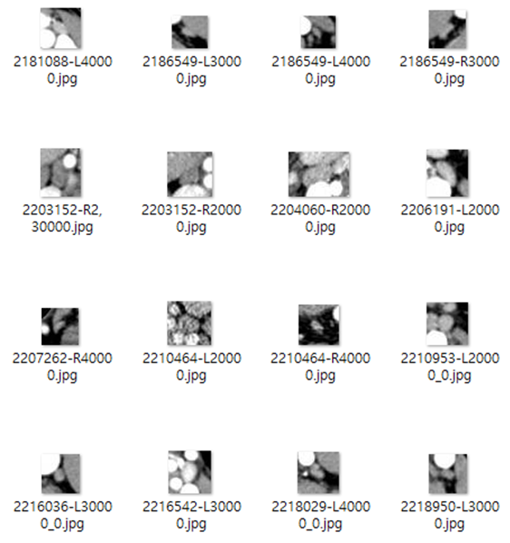
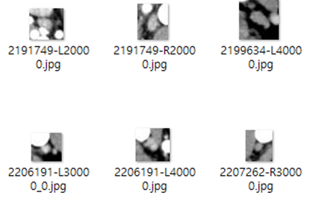

Deep learning – Data preprocessing
Training Data Set
about 70~80%
Validation Data Set
about 10~15%
Online Data Augmentation
Size, Angle, Contrast ....

Slide 13
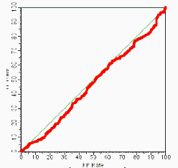
Deep learning – Data preprocessing
Training Data Set
about 70~80%
Validation Data Set
about 10~15%
Online Data Augmentation
Size, Angle, Contrast ....
1st Trial

Slide 14
Deep learning – Data preprocessing
Training Data Set
about 70~80%
Validation Data Set
about 10~15%
Online Data Augmentation
Size, Angle, Contrast ....
1st Trial

Slide 15
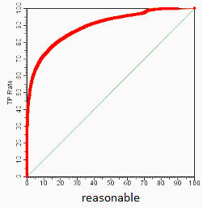
Deep learning – Data preprocessing
Training Data Set
about 70~80%
Validation Data Set
about 10~15%
Online Data Augmentation
Size, Angle, Contrast ....
1st Trial
2nd. Trial

Slide 16
Deep learning – Data preprocessing
Training Data Set
about 70~80%
Validation Data Set
about 10~15%
Online Data Augmentation
Size, Angle, Contrast ....
1st Trial
2nd. Trial

Slide 17
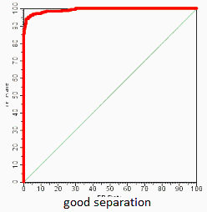
Deep learning – Data preprocessing
Training Data Set
about 70~80%
Validation Data Set
about 10~15%
Online Data Augmentation
Size, Angle, Contrast ....
1st Trial
2nd. Trial
3rd. Trial

Slide 18
Deep learning – Data preprocessing
Training Data Set
about 70~80%
Validation Data Set
about 10~15%
Online Data Augmentation
Size, Angle, Contrast ....
1st Trial
2nd. Trial
3rd. Trial

Slide 19
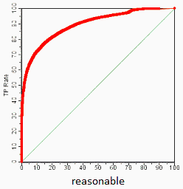
Deep learning – Data preprocessing
Training Data Set
about 70~80%
Validation Data Set
about 10~15%
Online Data Augmentation
Size, Angle, Contrast ....
1st Trial
2nd. Trial
3rd. Trial
4th. Trial

Slide 20
Deep learning – Data preprocessing
Training Data Set
about 70~80%
Validation Data Set
about 10~15%
Online Data Augmentation
Size, Angle, Contrast ....
3rd. Trial

Slide 21
Deep learning – Data preprocessing
Test Data Set
about 10~15%

Slide 22
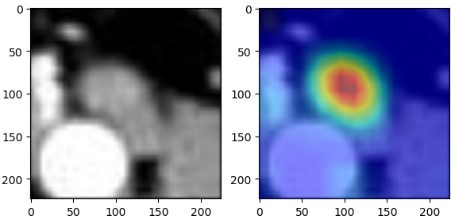
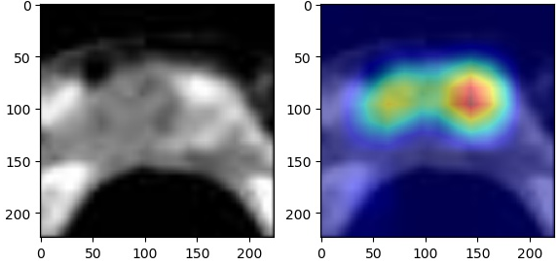
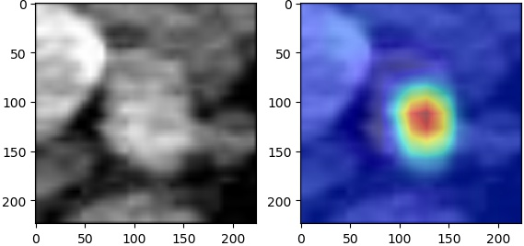
Deep learning – Data preprocessing
Test Data Set
about 10~15%
Our model achieved 98% accuracy!

Slide 23
Machine Learning Algorithms

Slide 24
AI algorithms
지도학습 [Supervised Learning]
종속변수에 해당하는 레이블(Label) 이 주어진 상태에서 학습시키는 방법
Classification, Regression ...
비지도학습 [Unsupervised Learning]
레이블 (Label) 없이, 데이터의 특징 및 구조를 발견하기 위한 방법론
딥러닝에서는 주로 Auto-encoder
강화학습 [Reinforcement Learning]
보상(Reward)를 얻기 위해, 모델이 수행하는 행동방식을
확률적으로 선택하도록 하는 방법론

Slide 25
지도 학습 [Supervised Learning]

Slide 26
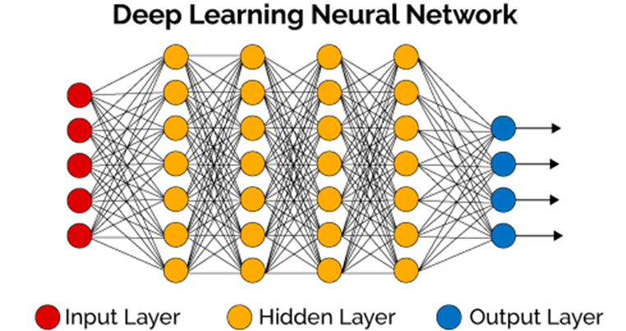
Deep Neural Network (DNN)
0
0
0
0
0
0
0
0
0
1
(9)

Slide 27
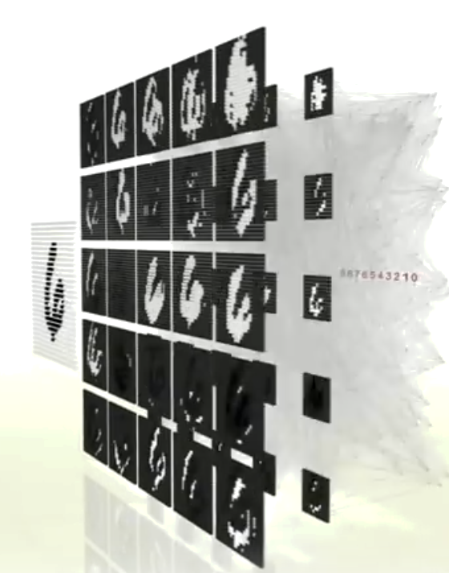

Convolutional Neural Network
Convolution & Pooling

Slide 28
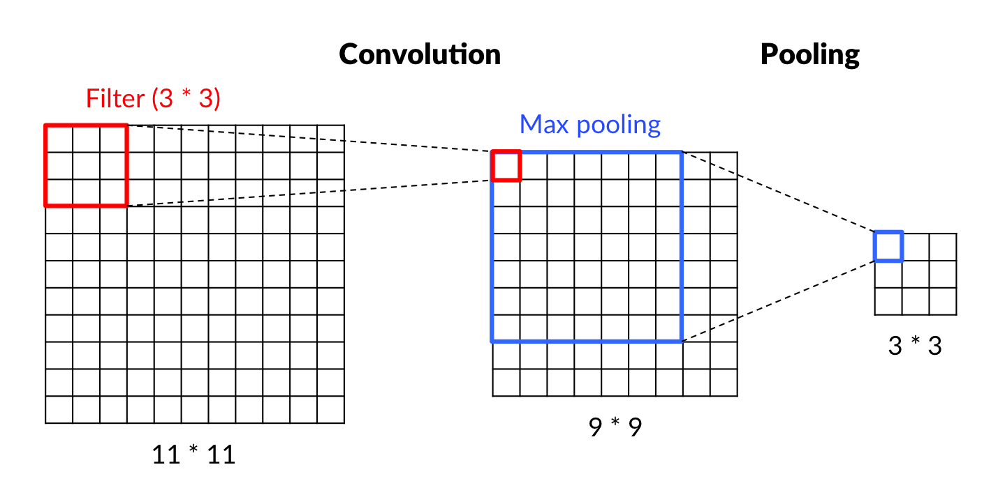
Convolutional Neural Network
Convolution & Pooling

Slide 29

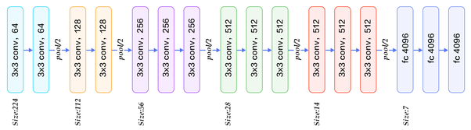
Convolutional Neural Network
VGG16

Slide 30
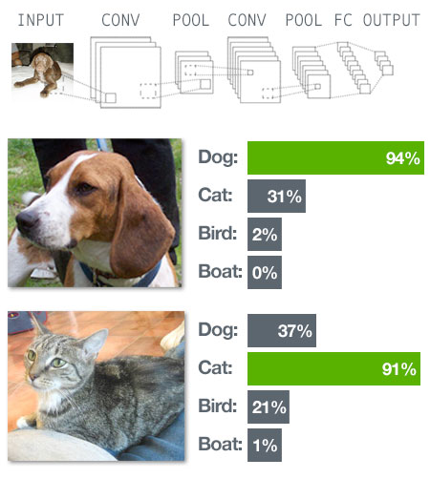
Convolutional Neural Network
VGG16

Slide 31
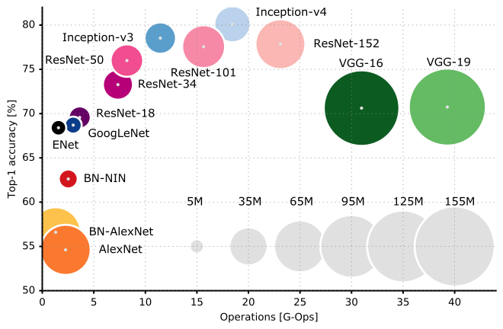
Convolutional Neural Network
Convolution & Pooling

Slide 32
지도 학습 [Supervised Learning]
with Class Activation Map

Slide 33
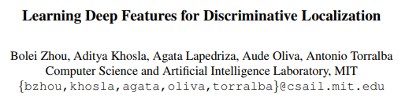
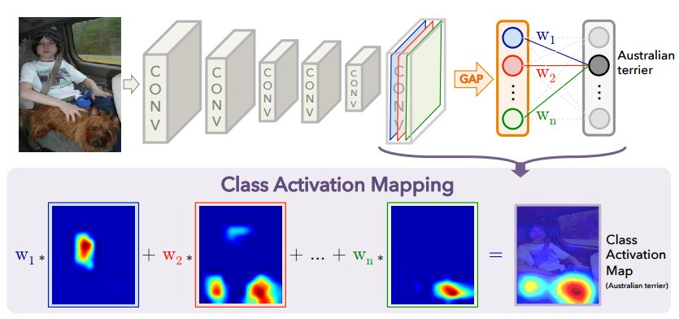
Convolutional Neural Network
Class Activation Map

Slide 34
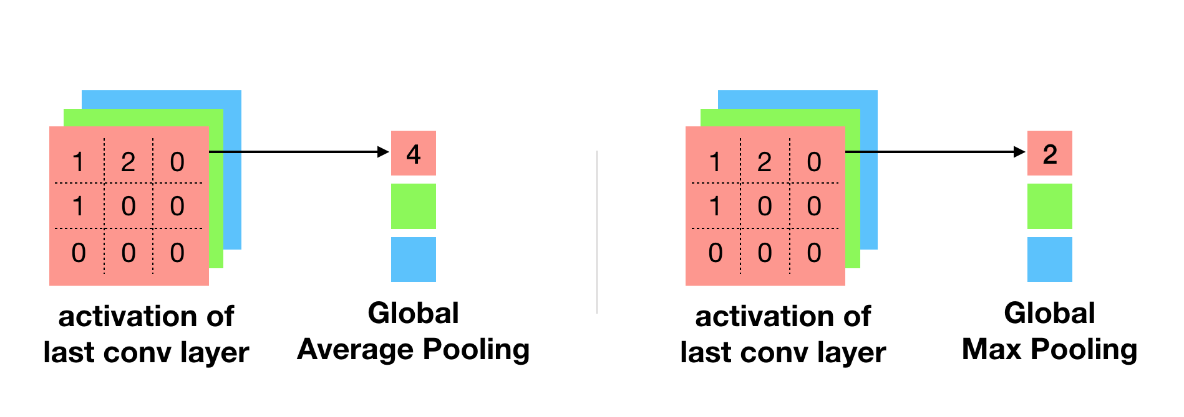
Convolutional Neural Network
Class Activation Map

Slide 35
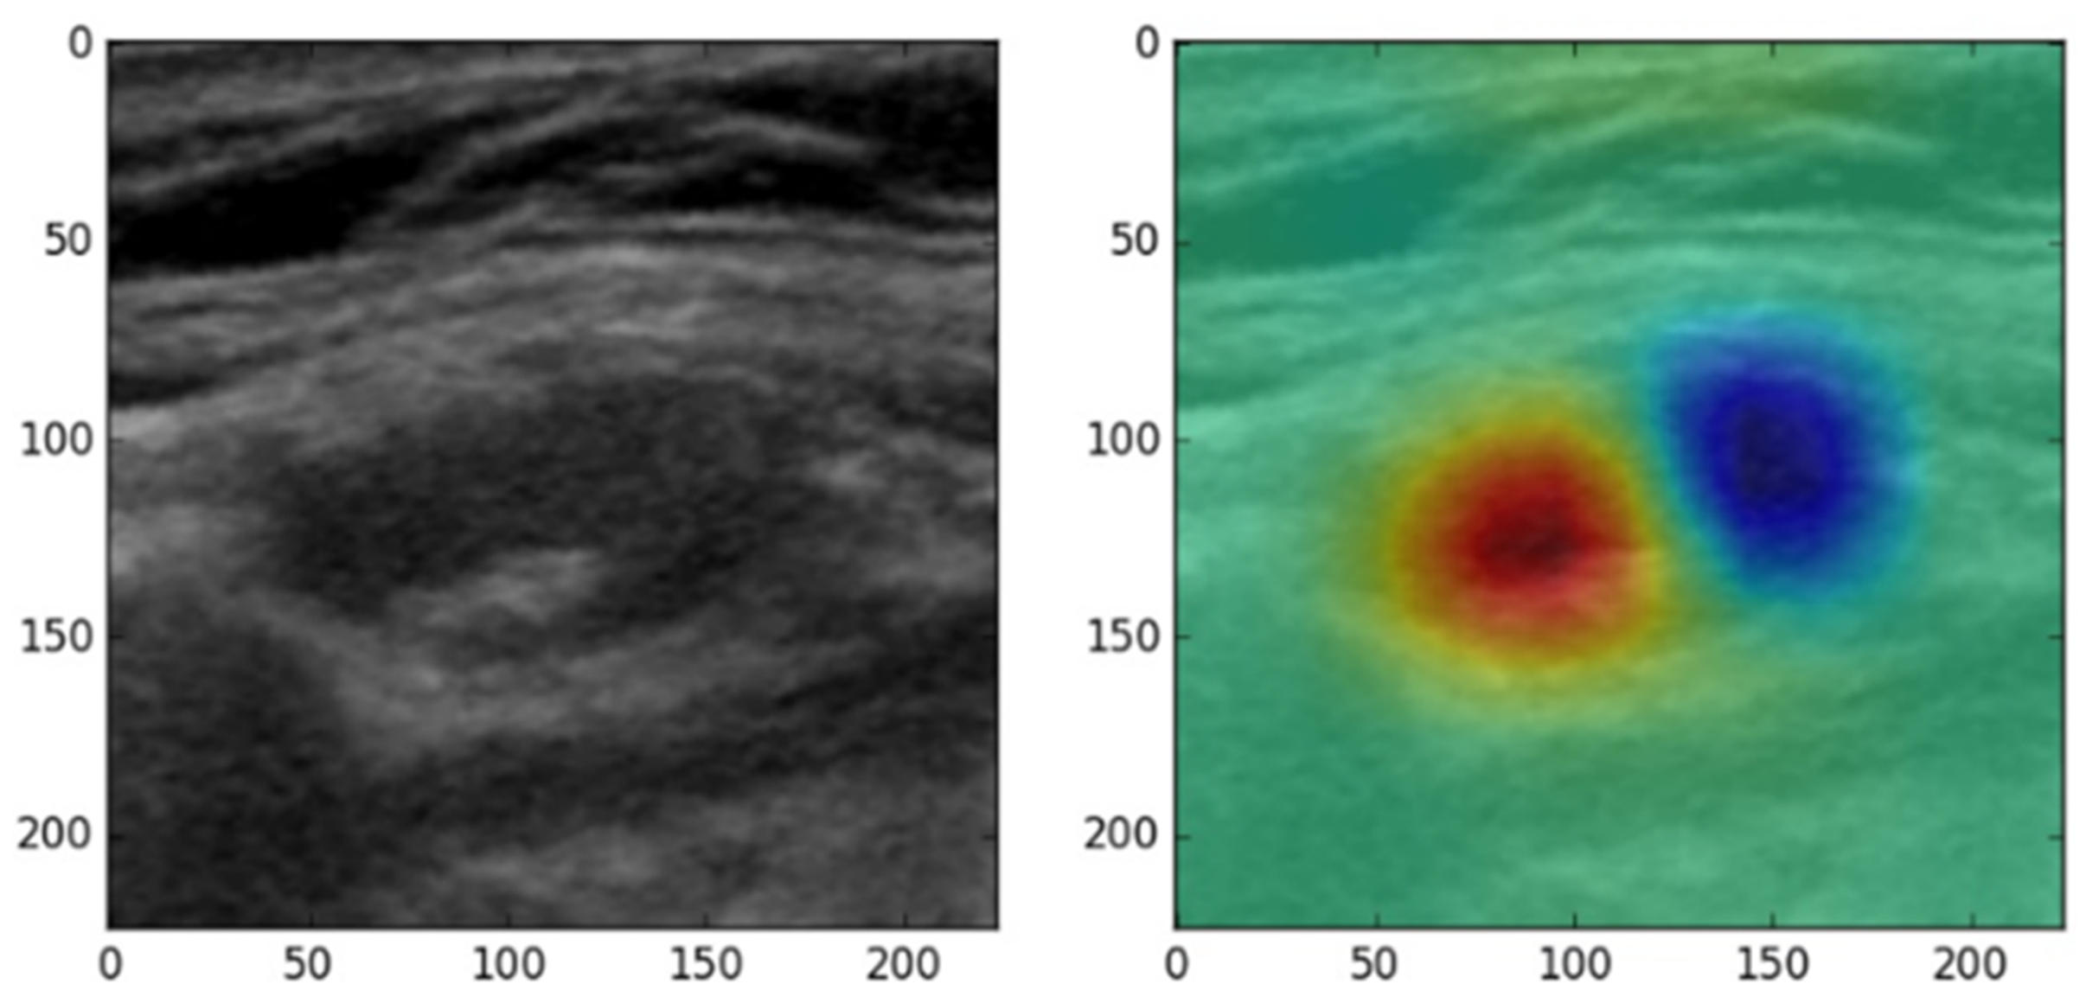
Convolutional Neural Network
Thyroid cancer lymph node metastasis

Slide 36
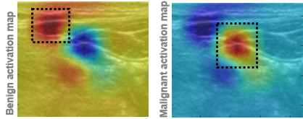
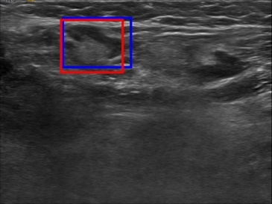
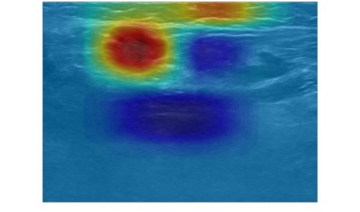
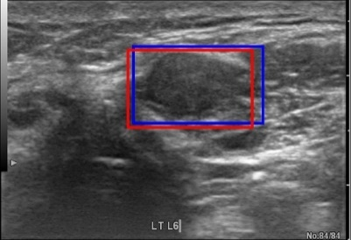
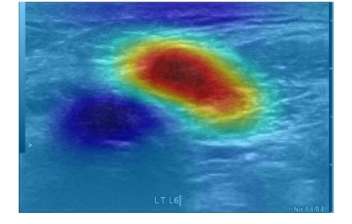
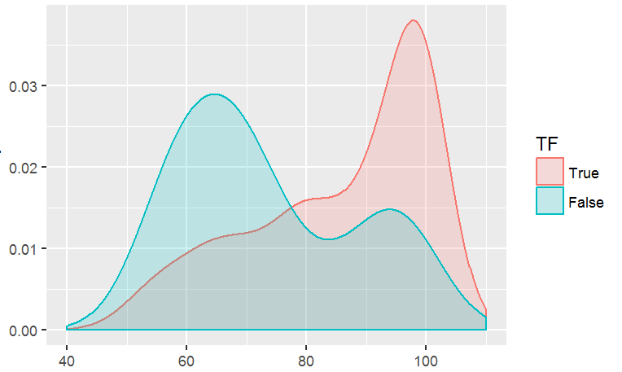
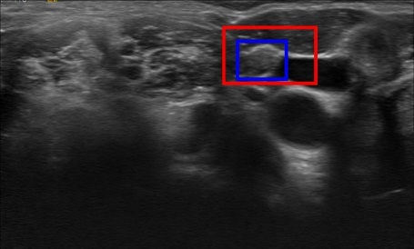
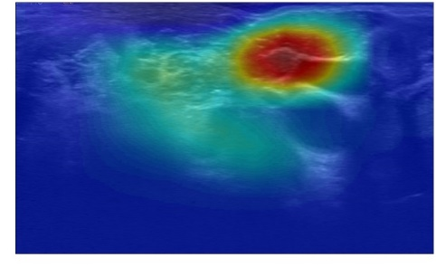
Convolutional Neural Network
Thyroid cancer lymph node metastasis
Red rectangle: Localized lymph node location
Blue rectangle: Mask area of ultrasound image

Slide 37
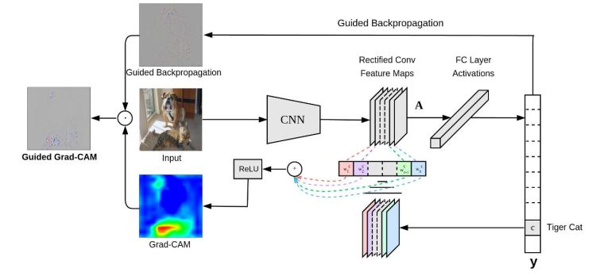
Convolutional Neural Network
Grad-CAM++

Slide 38
지도 학습 [Supervised Learning]
with Recurrent Neural Network

Slide 39
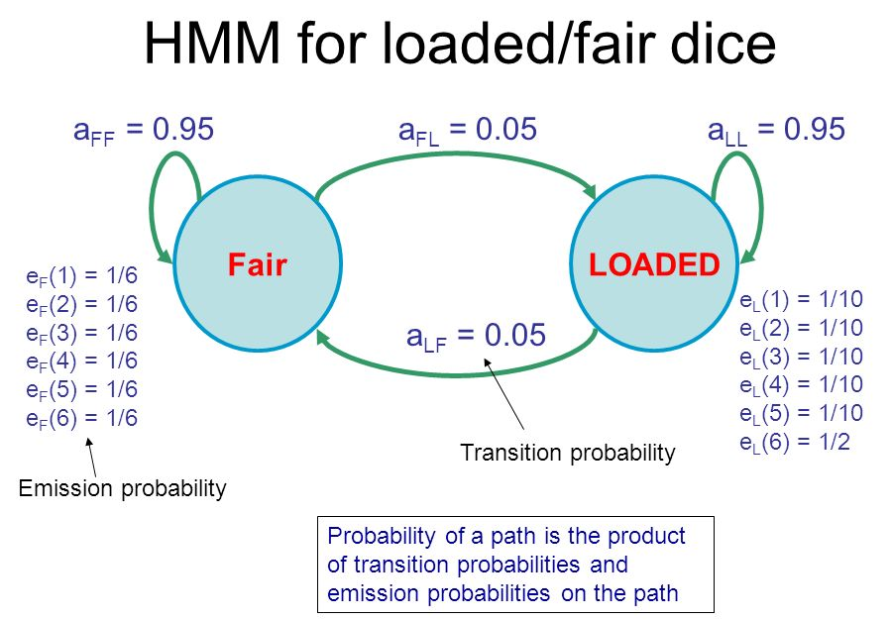
Recurrent Neural Network
Hidden Markov Model

Slide 40

Recurrent Neural Network
Recurrent Neural Network

Slide 41
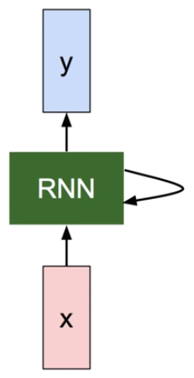
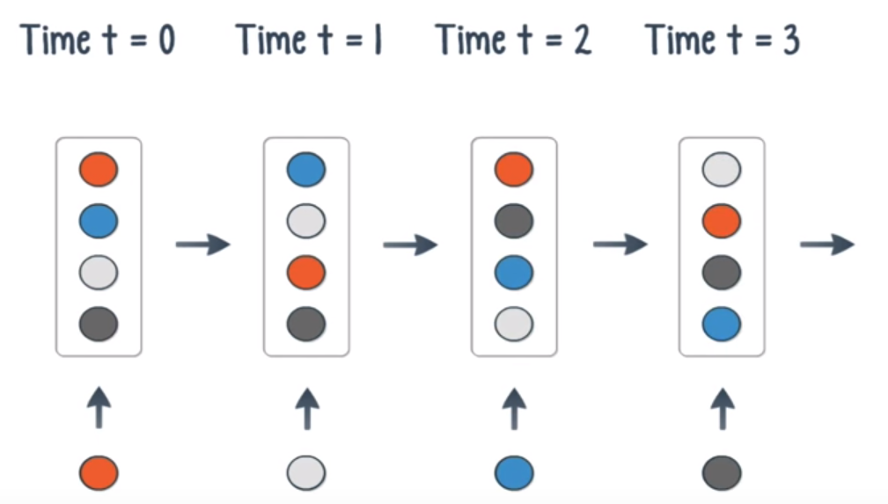
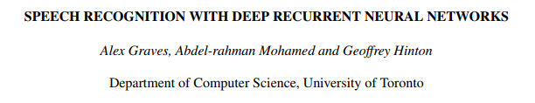
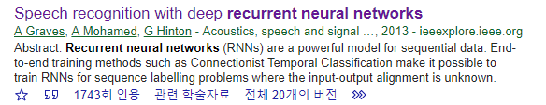
Recurrent Neural Network
Recurrent Neural Network

Slide 42
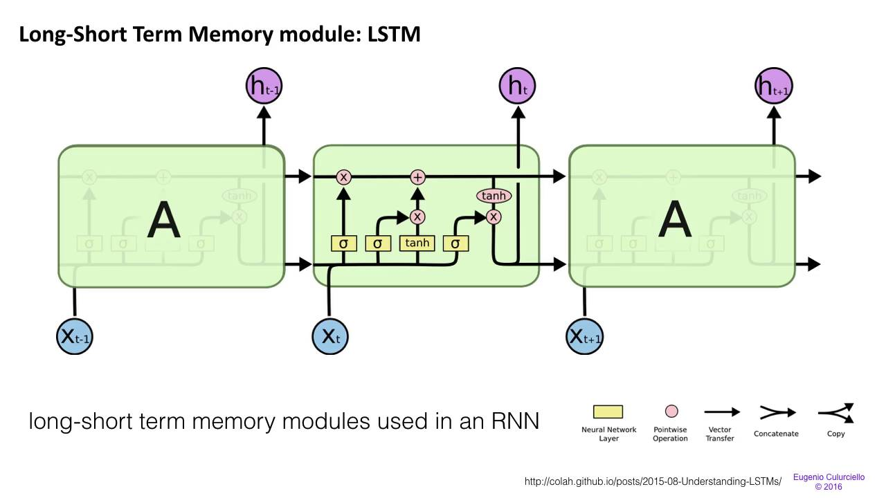
Recurrent Neural Network
Thyroid cancer lymph node metastasis

Slide 43
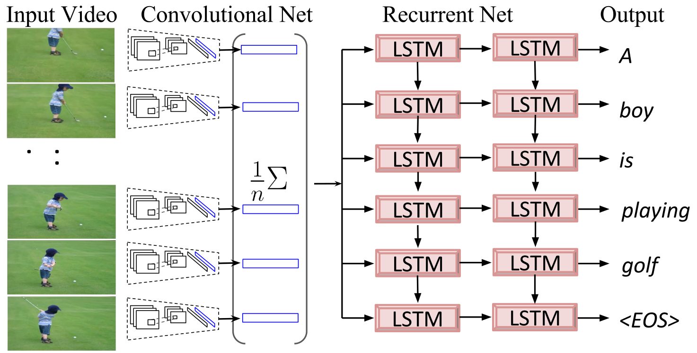
Recurrent Neural Network
Thyroid cancer lymph node metastasis

Slide 44

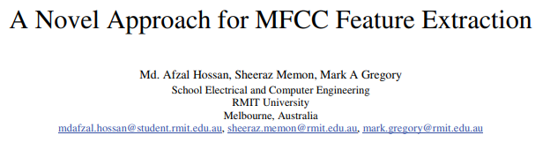
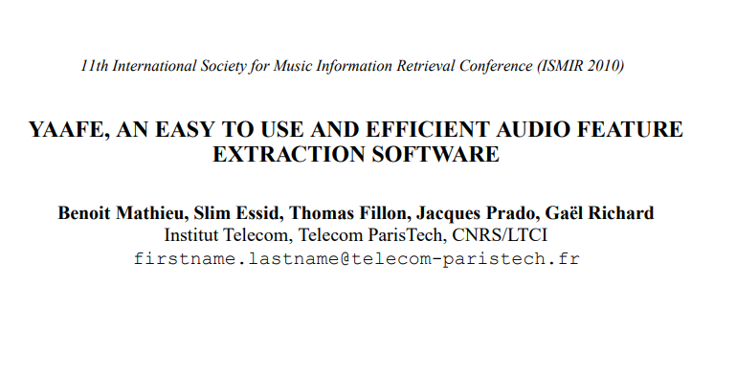
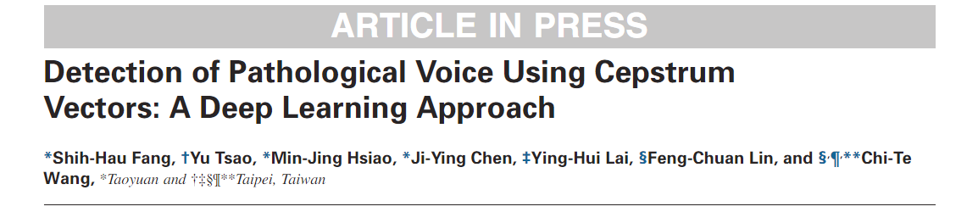
Recurrent Neural Network
Thyroid cancer lymph node metastasis
Pre-Emphasis
Framing
Windowing
Discrete
Fourier transform
Acoustic voice
Delta Energy and Spectrum
Discrete Cosine Transform
Mel Filter Bank
MFCCs feature

Slide 45




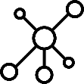

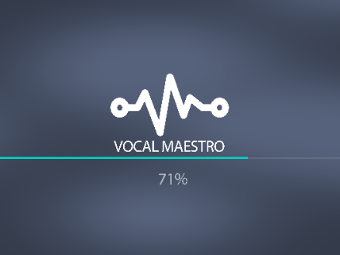


Recurrent Neural Network
Model
AI Server
Self diagnosis
Early diagnosis
Vocal fold nodules
Vocal cord attachment
Resonance point
Breathing
Vocal therapy
... ...
...
Electronic Medical Records (EMR)
Personal Health Record (PHR)
Lifelog Data
Time-series Voice Data Set
Vocal Maestro Application
User Input
Pre-Emphasis
Framing
Windowing
Discrete
Fourier transform
Acoustic voice
Delta Energy and Spectrum
Discrete Cosine Transform
Mel Filter Bank
MFCCs feature

Slide 46

Recurrent Neural Network

Slide 47

Recurrent Neural Network

Slide 48
비지도 학습 [Unupervised Learning]
Autoencoder

Slide 49

Principle Component Analysis

Slide 50

Principle Component Analysis

Slide 51
Principle Component Analysis

Slide 52

Principle Component Analysis

Slide 53

Principle Component Analysis

Slide 54



Auto-encoder
오토인코더는 Output을 Input의 근사로 하는 함수를 학습하는 비지도 학습

Slide 55


Auto-encoder

Slide 56

Auto-encoder
Loss

Slide 57
Auto-encoder
Loss

Slide 58
Auto-encoder

Slide 59
Auto-encoder

Slide 60

Auto-encoder

Slide 61

Auto-encoder
Retina blood vessel segmentation with U-NET

Slide 62
비지도 학습 [Unupervised Learning]
Generative Adversarial Network
적대적인

Slide 63

GAN: Generative Adversarial Network

Slide 64

GAN: Generative Adversarial Network

Slide 65



GAN: Generative Adversarial Network

Slide 66

GAN: Generative Adversarial Network

Slide 67

GAN: Generative Adversarial Network

Slide 68

GAN: Generative Adversarial Network

Slide 69

GAN: Generative Adversarial Network

Slide 70





GAN: Generative Adversarial Network
Real data

Slide 71

GAN: Generative Adversarial Network
CycleGAN

Slide 72

GAN: Generative Adversarial Network

Slide 73

GAN: Generative Adversarial Network

Slide 74

GAN: Generative Adversarial Network

Slide 75
Deep learning ETC

Slide 76


Image Augmentation
실무에서는 고성능의 모델을 학습할 만큼 데이터를 확보하지 못하는 경우가 많다.
이럴 때, 학습 데이터의 수를 늘리거나 기존에 학습된 인공신경망을 재활용 해야한다.

Slide 77
Online Augmentation
Training Data Set
about 70~80%
Random parameter + Augmentation
Online Data Augmentation
Size, Angle, Contrast ....

Slide 78
Pre-trained Model

Slide 79


Pre-trained Model

Slide 80

AutoML
https://autokeras.com/

Slide 81



AutoML

Slide 82
Research

Slide 83


AutoML
Thyroid IF: 7.557 (Accepted)

Slide 84


METHOD & Materials
Training Set
500 patients and 1,800 US images with rectangle mask image
Notes:
The study was conducted using 1800 ultrasound images and masks, in total 500 patients.
The mask image points to the location of the lymph node, but not the shape of the lymph node.
Since creating a mask image is very labor intensive, we decided not to use the mask image as an input to learning.

Slide 85



METHOD & Materials
CLASSIFICATION
Class Activation Map
GoogLeNet
(Convolution Neural Network)
Reliability
Amplified Images
Benign
80%
Malignant
Benign
20%
Benign
conv
conv
LOCALIZATION
conv
conv
Malignant
conv
INPUT
GAP
RESULT
Benign
*GAP: Global Average Pooling
Class Activation Map: (Zhou, Bolei, et al., 2016)
Notes:
Because ultrasound images have various noises such as muscles, blood vessels and fat, we focused on the lymph nodes when amplifying the images.
The training images were amplified 50 times for each images, and the test images were also amplified 50 times.
In the modeling step, we used a model that can perform classification and localization of lymph nodes simultaneously by combining a deep learning algorithm called GoogLeNet and a class activation map.
As a result, we get two results from the ultrasound image used as an input.
First, the Reliability. 85% of the amplified 50 images from one input image were predicted as benign. This is defined as Reliability and is a measure of how accurately we predicted the outcome.
The second result was a heat map showing the location of the lymph nodes.
A red highlighted heatmap indicates the location of the lymph node.

Slide 86
RESULT Model performance
< 0.001 ***
12.29164
18.688
kruskal-Wallis p-value
Mean of difference
chi-squared
Test data set
accuracy
96.8%
83.0%
Model performance
Validation set
accuracy
83.0%
The performance of our model
has been well attained in
all evaluation items.
VALIDATION SET
Sensitivity
79.5%
VALIdation set
Specificity
87.5%
Reliability (%)
Notes:
A total of 63 images were used in the test set and the accuracy was 96.8%.
In the validation set, accuracy was 83.0%, sensitivity and specificity were 79.5% and 87.5%, respectively.
This graph is a density graph of reliability.
Reliability was higher in the correct case than the wrong case.
The Kruskal-Wallis p-value was significant, and the mean of difference is over than 12.
This means that reliability is an important factor in determining the outcome.

Slide 87

RESULT TRUE Positive & TRUE negative
Malignant
Benign
fatty hilum
activation
Malignant
cell infiltration
Notes:
This is an example of True positive and True negative results.
The image on the left is Benign case, and the image on the right is a Malignant case.
In the benign image, a heatmap is drawn on the area where Fatty hilum activation occurs. In other words, it can be interpreted as predicting the benignity through the biological phenomenon called Fatty hilumn activation.
The right side is a case showing cell infiltration, which is mainly observed in malignant patients. In our software, we can see that the heatmap is emphasized on the area that looks like cell infiltration.
Therefore, when artificial intelligence distinguishes benign from malignant, it can be distinguished by biological phenomena.
This allows us to understand how the software classifies it.

Slide 88




RESULT false Positive & false negative
Malignant
Pred. Benign
Benign
Pred. Malignant
Notes:
This is False positive, False negative case.
The software was able to locate the lymph node, but predicted the malignant to be benign.
Through the heatmap picture below, it can be seen that artificial intelligence is focused on the blood vessels and predicted to be malignant.
This means that we can see why artificial intelligence classifies this image as malignant.

Slide 89

CONCLUSION Research
Problem: classification & localization
Class Activation Map
CLASSIFICATION
Benign
Reliability
Benign
Benign
75%
Malignant
25%
Differentiation of Thyroid Malignant Lymph Node from Benign Lymph Node using Artificial Intelligence
Malignant
model of flexibility
Simultaneous classification and
localization in one model
A mask is not necessary for newly added data
Benign
LOCALIZATION
Performance
83% classification accuracy
Reliability of Results
Reliability of classification results
Availability of Localization Information
Notes:
This is the conclusion.
We have developed an artificial intelligence program using Convolution neural network and Class activation map.
We have implemented a software that can predict malignancy of lymph node and where the lymph node is located.
These two functions are performed simultaneously. This is the advantage of software we made.
As a result, 83% accuracy was obtained.
Artificial Intelligence If our answer is wrong, we can see why the error is due to the heatmap, so I would like to call that our software is a feedback enabled system.

Slide 90

Research
Thyroid IF: 7.557 (Submitted)

Slide 91


Research

Slide 92



Research
RESPIROLOGY IF 4.407 (Under review)
Deep learning based pleura cancer invasion detection

Slide 93

Research

